Slide 1
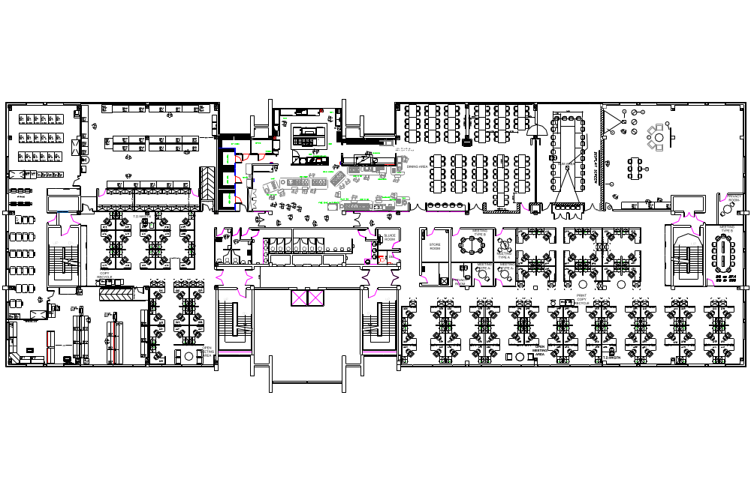
Dromore House 1st Floor
Conference Room Locator
Heaney
Yeats
Joyce
Clarke
Shaw
Wilde
Beckett
Behan

